Slide 1

NEXTGEN ANALYTICS
TEAM MEMBERS:
Sylvester Vhashe |Bekithemba Nkomo | Innocent Mujokoro | Tapiwanashe Mutarimanja

Slide 2
TITLE :
Navigating Complaints to Comfort: A Data-Driven Approach to improve Tenant Living Standards.
Client:
Urban Edge Properties
Welcome to our analysis of housing conditions and code compliance in New York City, where we leverage data to understand tenant experiences and identify critical areas for improvement.

Slide 3
STORY
Urban Edge Properties recently acquired a portfolio of multifamily residential properties across New York City. These properties, while strategically located, come with a legacy of operational challenges. They were previously managed by HRMS, a company with a long-standing reputation for inconsistent housing code compliance, frequent tenant complaints, and lagging response times to maintenance issues.
Upon acquisition, Urban Edge quickly recognized that these inherited challenges could jeopardize their investment goals, damage tenant relationships, and expose them to regulatory risk if not addressed. But before they could implement meaningful improvements, they needed clear visibility into the depth and nature of the problems across boroughs, buildings, and complaint categories.
With a strong commitment to raising the standard of living for tenants, restoring building integrity, and modernizing operations, Urban Edge reached out to NextGen Analytics for highlighting areas. Their goal seeks to uncover root causes and patterns to reduce complaints, enhance building safety, and ensure compliance with NYC housing regulations.

Slide 4

SPONSOR OVERVIEW
Urban Edge Properties
Urban Edge Properties is a real estate development and property management firm specializing in residential and commercial properties across New York. UrbanEdge is committed to sustainable urban living, ensuring tenant safety, and maintaining compliance with city housing codes and safety standards.
PAIN POINT:
Urban Edge inherited properties with a legacy of tenant complaints, poor compliance, and reactive maintenance. The company seeks to uncover root causes and patterns to reduce complaints, enhance building safety, effective resolution of tenant issues and ensure compliance with NYC housing regulations.

Slide 5
Urban Edge OBJECTIVES
To reduce complaint volume,
Improve building safety and maintenance practices,
Ensure timely and effective resolution of tenant issues,
Strengthen compliance with NYC housing codes to reduce violation rate.

Slide 6
NextGen INSIGHTS TO DELIVER
KPI’s for Complaints and Violations
Geospatial Complaint & Violation Distribution,
Complaints by buildings,
Complaint & Violation Trends Over Time (2022–2024),
Complaint Category Breakdown ,
Monthly Complaint Seasonality,
Violation Resolution Timelines by Priority.

Slide 7






TOP KEY PERFOMANCE INDICATORS.
Insight:
Total Complaints: 1.17M
Complaint-Driven Violations: 250.29K
Avg. Complaint-to-Violation Rate: 20%
Top Borough by Violation Rate: Bronx
This indicates that 1 in every 5 complaints results in a violation, and the Bronx is the area with the highest violation rate across all boroughs.
Implication
A 20% conversion rate from complaints to violations signals a high risk of non-compliance and possible operational inefficiencies in property management.
The Bronx portfolio is under heightened scrutiny and may be contributing disproportionately to enforcement actions.
These trends may lead to increased legal costs, fines, and reputational damage, especially if left unaddressed.

Slide 8
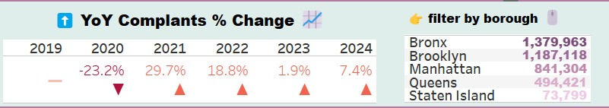
TOP KEY PERFOMANCE INDICATORS.
Insight:
Complaints dipped in 2020 (possibly due to covid) but spiked again in 2021 and has since been increasing.
Bronx, Brooklyn and Manhattan have the highest volume of complaints in every year across all years.

Slide 9
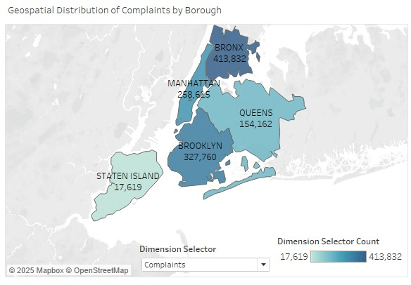
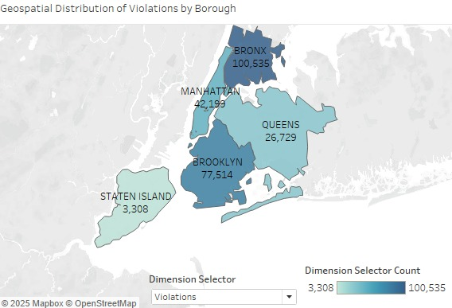
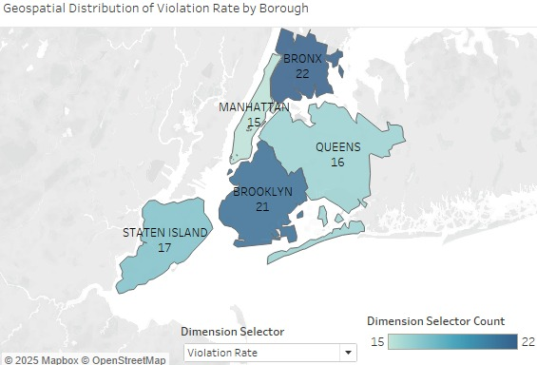
Geospatial Distribution of Complaints and Violations
Insights
Complaint Volume: The Bronx reported the highest complaint count (413,832), followed by Brooklyn (327,760) and Manhattan (258,625). Staten Island had the lowest (17,619).
Violation Rate: The Bronx (22%) and Brooklyn (21%) exhibited the highest violation rates. Manhattan had the lowest (15%). Staten Island's violation rate was 17%.
Implications for Urban Edge
HRM's failure to efficiently resolve issues in the Bronx and Brooklyn likely caused a backlog and tenant dissatisfaction.
The disparity in violation rates, with Manhattan's low rate despite high complaints, suggests that better systems are achievable but were not evenly applied across boroughs.
Staten Island's combination of low complaint volume and a notable violation rate points to potential neglect or misallocation of resources under HRM.
Recommendations
Operational: Prioritize interventions in the Bronx and Brooklyn due to high complaint volume and violation rates, focusing on high-density housing with proactive inspections and quick repairs. Implement a rapid-response unit in Staten Island to address backlogs and improve resolution times.
Communication
Conduct a public rebranding effort in affected boroughs like the Bronx, informing residents about new management and improvement plans to rebuild trust. Initiate borough-specific outreach campaigns to understand key tenant concerns and establish realistic resolution timelines.

Slide 10
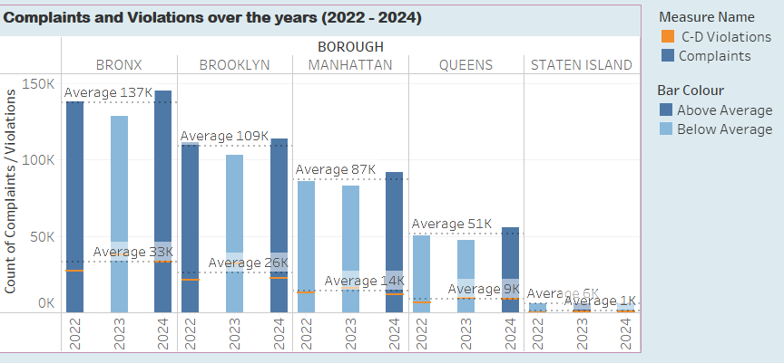
COMPLAINTS AND VIOLATIONS OVER THE YEARS
Insight
Bronx leads in both categories, with an average of 137K complaints and 33K violations, consistently above average.
Brooklyn and Manhattan follow with 109K and 87K average complaints, respectively — but Brooklyn’s violation count (26K) is notably higher than Manhattan’s (14K), despite similar complaint levels.
Queens (51K complaints, 9K violations) and Staten Island (6K complaints, 1K violations) remain below average, signalling lower risk or better performance but do not mistake silence for success.
While Brooklyn reports a high volume of complaints, it shows fewer violations — suggesting more effective maintenance practices or enforcement models.
Implication
Sustained high volumes in Bronx/Brooklyn suggest persistent compliance challenges.
Queens’ increase may signal early-stage deterioration in property standards.
Recommendations
1. Bronx: Intensive Operational Overhaul
Designate the Bronx as a priority intervention borough.
2. Study Brooklyn’s operational approach. Are policies, tenant communications, or maintenance systems more efficient? If so, replicate those practices across other boroughs.
3. Implement resident awareness campaigns in Queens and Staten Island, and proactive inspections to surface hidden issues early.

Slide 11
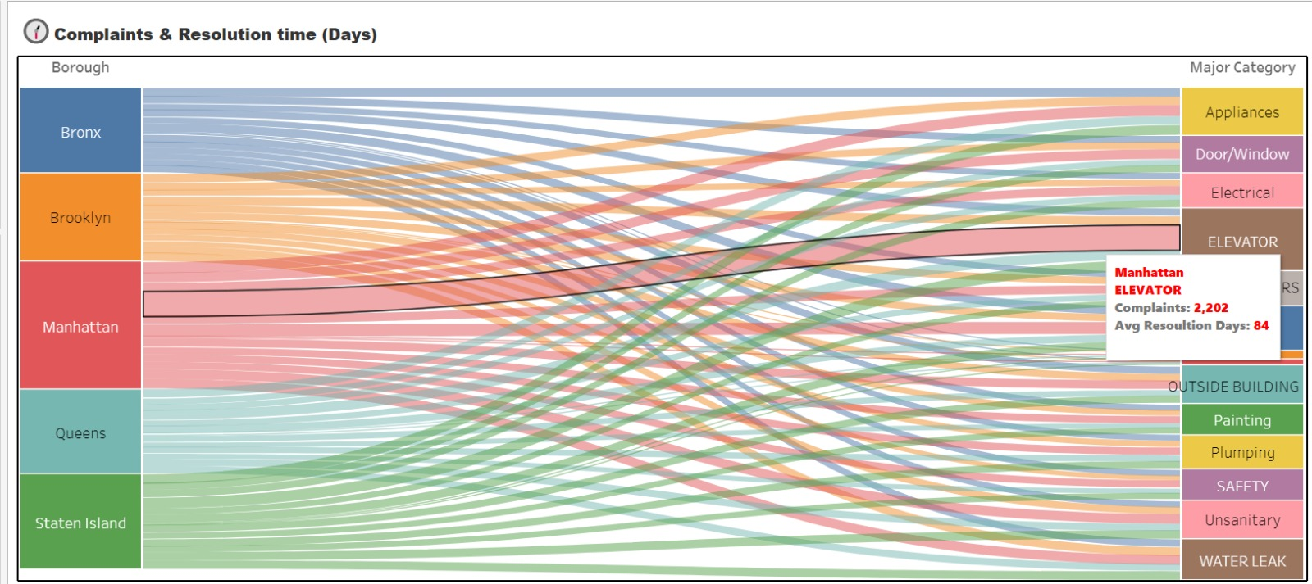
COMPLAINTS BY MAJOR CATEGORY
Insights:
Manhattan has a significant higher average resolution time on Elevators (84 days). This indicates that elevator issues are significantly delayed even though the complaint count isn’t the highest
Quicker resolution in Staten Islands and Queens- generally thin links on these 2 boroughs - This could be because these 2 benefit from smaller case volumes or more maintenance systems.
Resolution delays are category - specific and not just borough based - categories like heating tend to have thin links regardless of borough. This implies that certain issue types are harder to fix on involve more logistics or regulatory delays.
Our Recommendations:
1. Consider adding specialists for specific categories to deal with these specific category related issues
2. Invest in system upgrades and pre-winter maintenance for heating systems in these two boroughs. These improvements will reduce complaints, increase tenant satisfaction, and minimize costly emergency repairs.
3. Create a quarterly integrated pest management (IPM) program across high-risk properties and include tenant education on waste management practices.
4. Implement preventive plumbing inspection schedules and mandate faster response time SLAs (Service-Level Agreements) for all leak-related tickets.

Slide 12
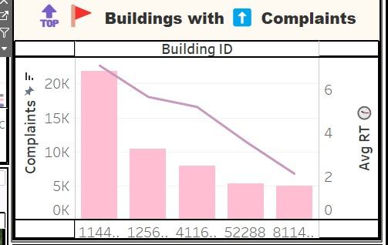
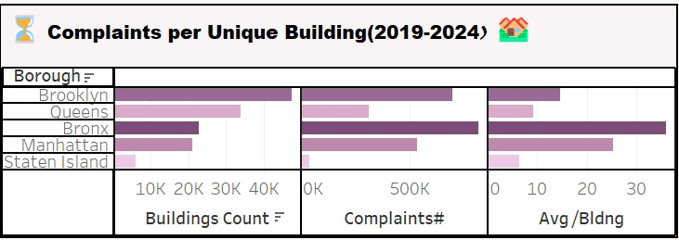
TOP BUILDINGS WITH MANY COMPLAINTS
Insight
There’s a cluster of problematic buildings generating disproportionately high complaints and taking longer to resolve issues.
Bronx has the highest Complaint volumes despite fewer buildings- these buildings are under high maintenance stress indicating systematic issues (possibly due to aging infrastructure),
Staten Island has relatively low issue frequency, suggesting better housing conditions or fewer residents per building
Recommendation
Target these high complaints Buildings for immediate audits
Improve resource allocation in the Bronx( repair crews, preventative maintenance scheduling)
Understand what’s working in Staten Island and use it as a benchmark in other boroughs

Slide 13
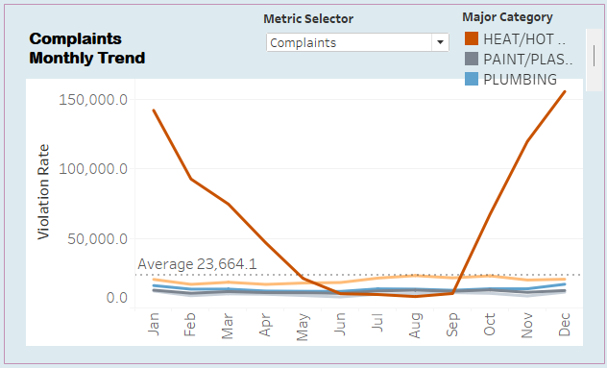
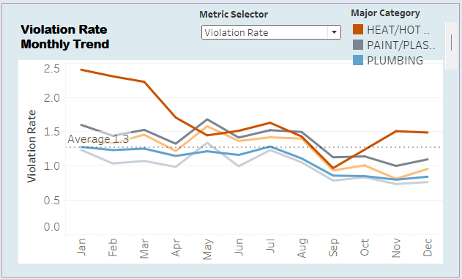
COMPLAINTS AND VIOLATION MONTHLY TRENDS
Insights:
Heat/Hot Water issues show a sharp seasonal pattern—peaking in winter (Dec–Feb) and dropping in summer.
Other issues like Plumbing, Paint/Plaster, and Water Leaks remain steady and below average throughout the year.
Implications:
There is a predictable winter crisis in heating services, indicating a lack of seasonal preparedness.
Persistent, non-seasonal issues suggest ongoing maintenance gaps needing attention.
Recommendation:
Prepare heating systems by September with proactive inspections and repairs.
Maintain year-round routines for plumbing, leaks, and other issues.
Allocate more resources in winter and leverage this data for better planning and policy decisions.

Slide 14
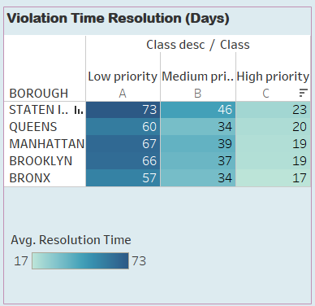
VIOLATION RESOLUTION TIME
Insights
Staten Island has the longest average resolution time (73 days), while the Bronx has the shortest (57 days).
Queens resolves medium-priority violations the fastest (34 days).
Significant variation exists between boroughs for all priority levels.
Implications
Resource Disparities: Staten Island may lack adequate resources, leading to inefficiencies.
Operational Efficiency: Differences in processing may indicate the need for improved operational practices.
Recommendations
Increase Resources: Allocate more staff and resources to Staten Island.
Regular Monitoring: Establish ongoing tracking of resolution times for accountability.

Slide 15
Conclusion:
Complaint and Violation Trends:
Brooklyn records the highest number of complaints, but a lower percentage of them turn into violations.
The Bronx has the highest violation rate (~22), suggesting more severe issues.
Resolution Efficiency:
Brooklyn, The Bronx and Manhattan resolve violations faster, whereas Staten Island experiences prolonged resolution times, indicating systemic inefficiencies.
High-priority violations take approximately 23 days to resolve, but lower-priority issues can take nearly three months.
Geographic & Seasonal Insights:
Complaint hotspots are concentrated in Brooklyn and the Bronx, highlighting the need for targeted enforcement.
Heat/Hot Water complaints peak in winter, suggesting a need for proactive interventions during colder months.
Long-Term Trends & Policy Implications:
While the number of resolved complaints has increased significantly over the years up to 2024, the rise in open complaints suggests a growing backlog.

Slide 16

Key Findings & Next Steps
With the right strategy, Urban Edge can:
Stabilize underperforming assets (The Bronx)
Uncover hidden risks (Queens & Staten Island)
Build seasonal resilience across all properties
Explore and replicate operational practices from Brooklyn, such as:
Maintenance protocols,
Tenant communication systems,
Compliance management frameworks.
This data isn’t just informative — it’s actionable. And we’re here to help you use it to build trust, raise standards, and realize the full value of your investment.

Slide 17
How Can We Improve NYC Housing Conditions?
Proposed Actions:
Targeted interventions in Bronx & Brooklyn.
Resource reallocation to reduce backlog.
Policy reform to streamline low-priority violations.
More frequent inspections to prevent issues before complaints arise.
Final Thought:
Data is a powerful tool for improving city enforcement towards livability in NYC — let’s use it

Slide 18
Thank You

